Slide 1
Best location for Hotel in Tirupati
Coursera Capstone Project

Slide 2
Hotel Location in Tirupati
Tirupati is one of the most visited pilgrimage for Hindus all over the world with an annual estimation of close to 40 million visitors
The challenge is to find a good location for a new hotel/restaurant which is close to the city center and all the other famous venues

Slide 3
Data Source to be Used
We will use Foursquare data to explore the location and its different venues nearby
We will look for midpoint of area of venues and then try to locate our hotel.
Our location is center of Tirupati

Slide 4
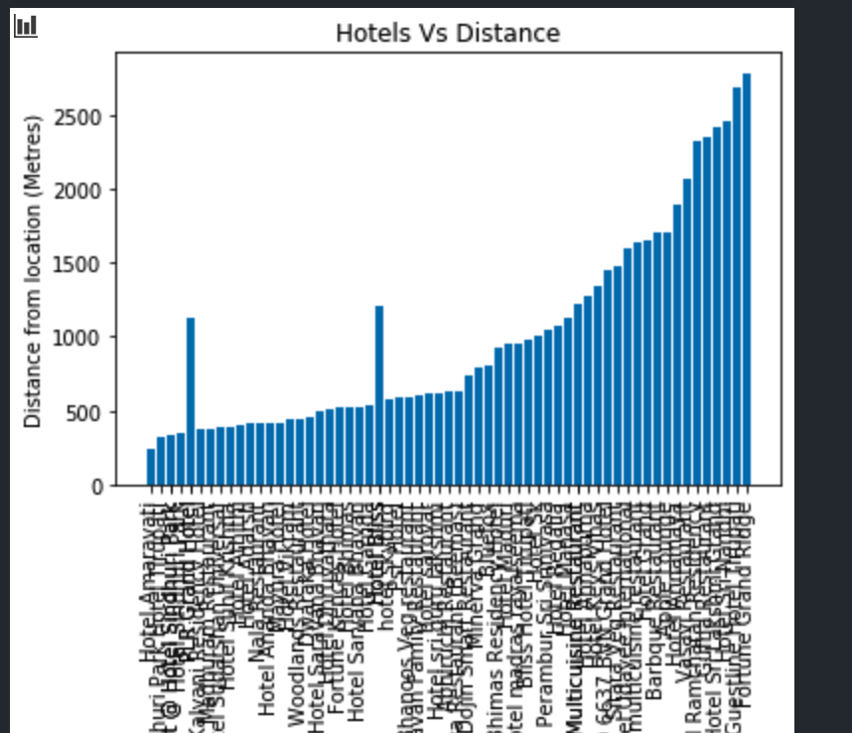
Current Analysis
There are 65 Hotels and Restaurants near Tirupati
Average distance between our core location to the different hotels is about 975 meters

Slide 5
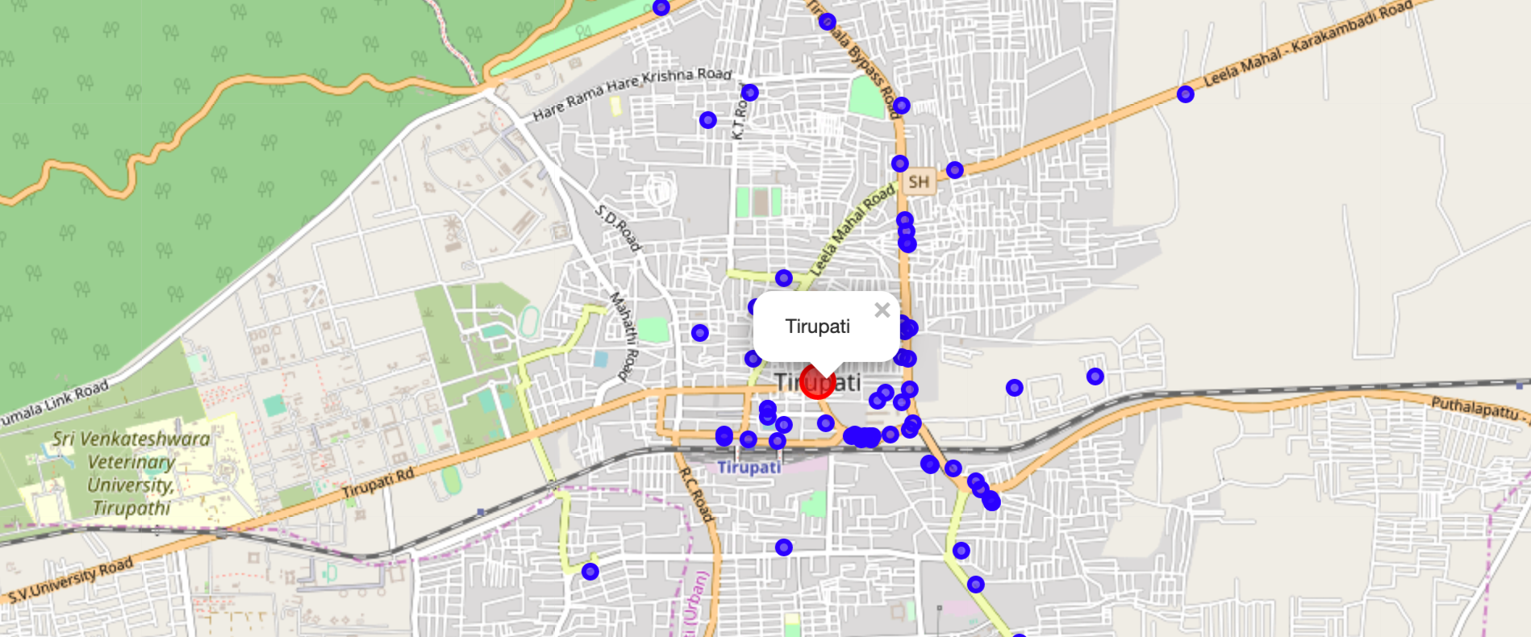
Map of the Hotels

Slide 6
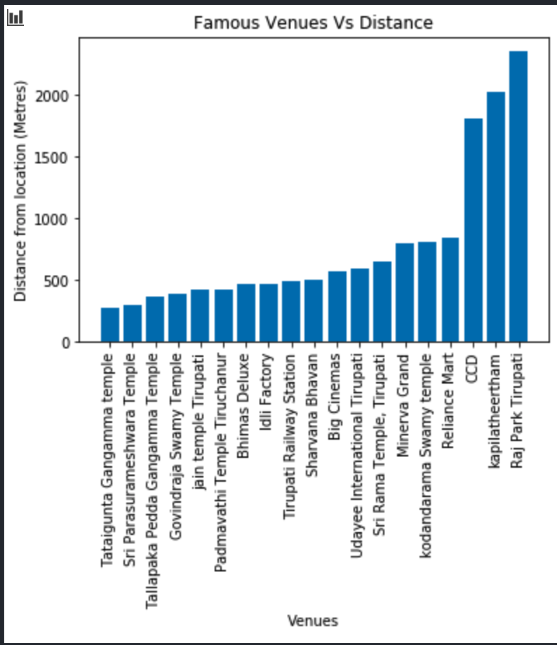
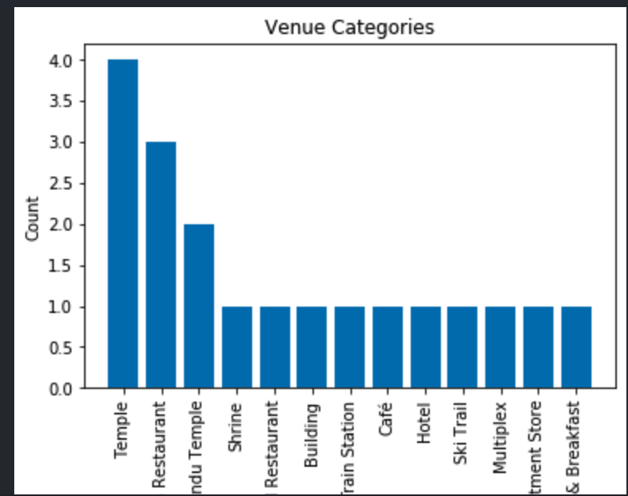
Distance of Venues and Categories

Slide 7
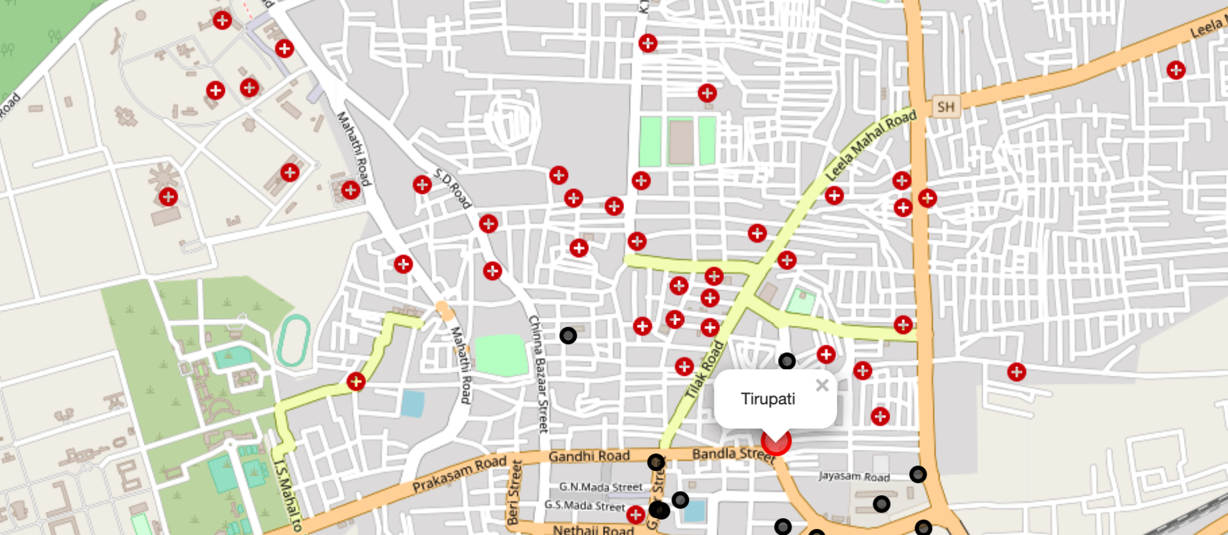
Map of Venues

Slide 8
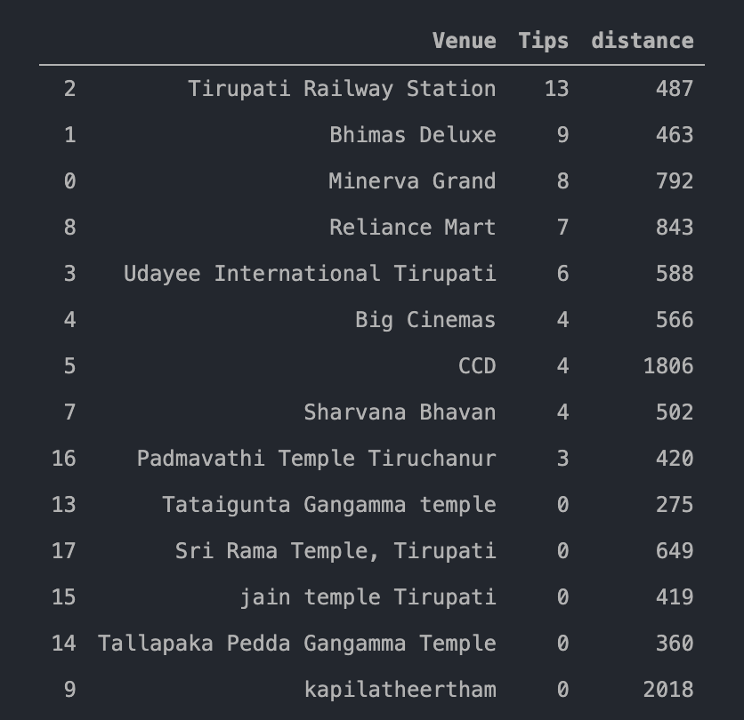
Ratings and Tips

Slide 9
Clustering
Find the center location of the top rated venues
First we find the clusters and then we will take the average of all centers
Then we can take the midpoint of the shortlisted highly rated venues
We can then find our best location

Slide 10
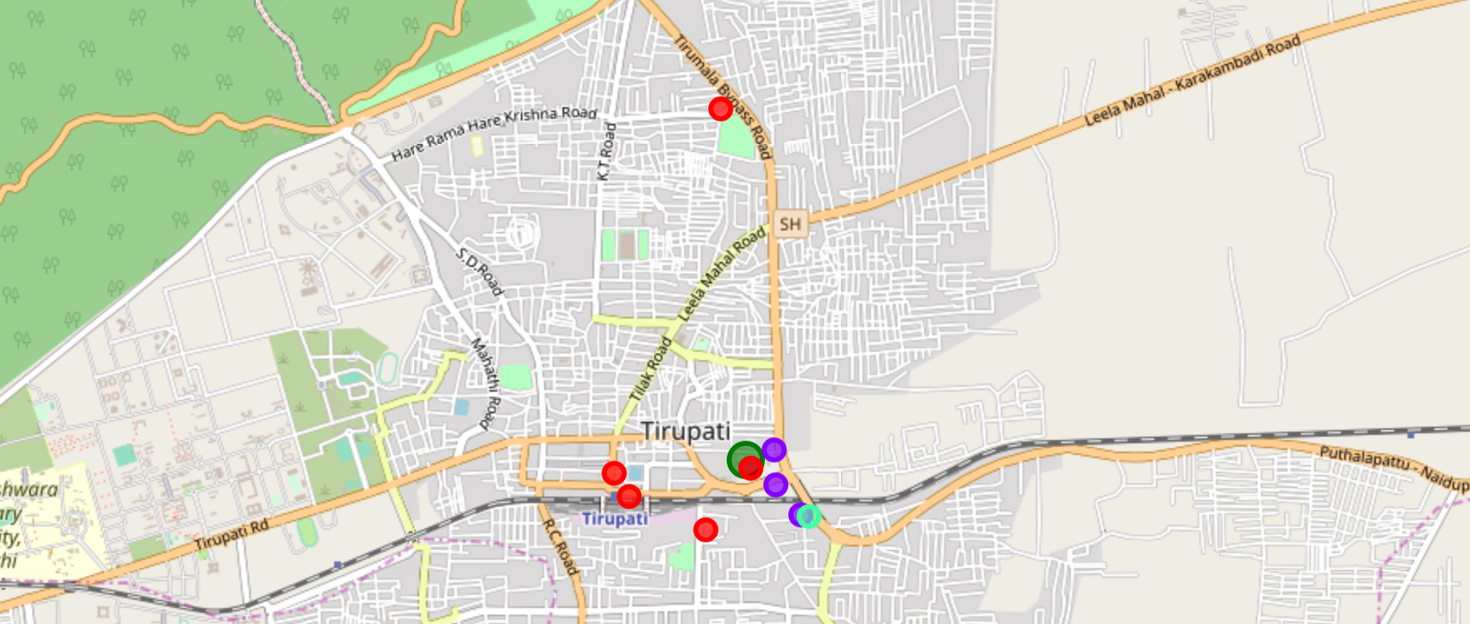
Clustered Map

Slide 11
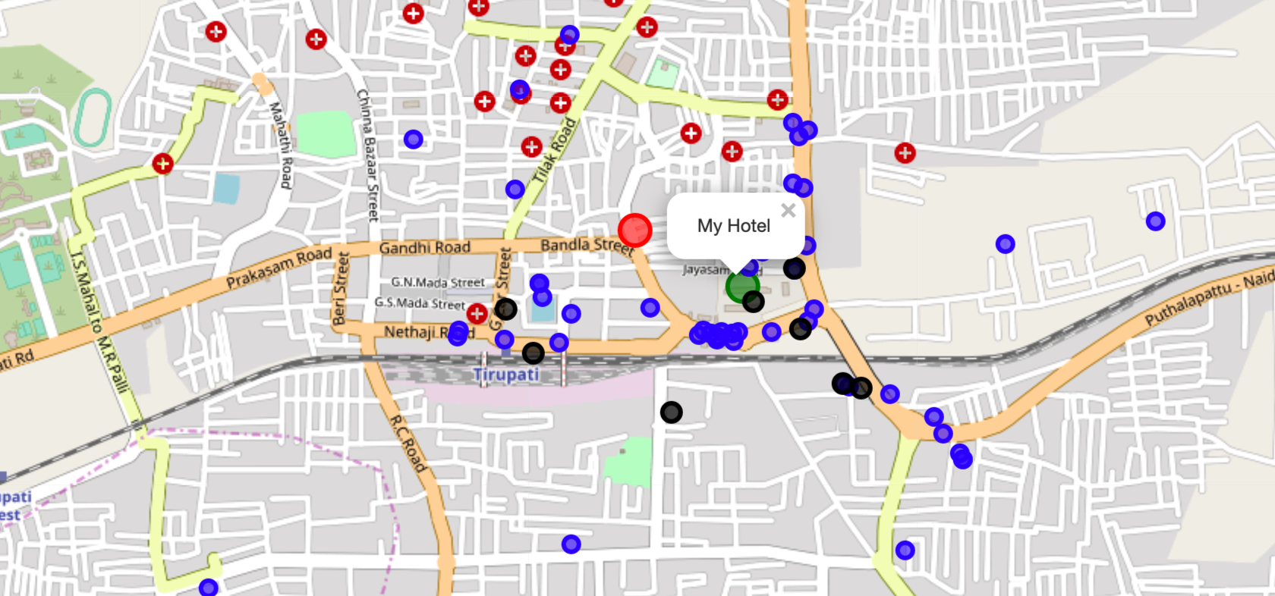
Combined Map with Recommended Site

Slide 12
Final Location
The final location address is as follows :
Tirupati Central Bus Station, Jayasam Road, Tirupati, Tirupati (Urban), Chittoor, Andhra Pradesh, 517500, India
The latitude and longitude are 13.630111219550525,79.4262345628025

Slide 13
Thanks
Thanks for reviewing and hope you had as much fun in learning as I had in this course.

